Slide 1
Used Car price prediction with Deployment
Group : CC-Fall-2023 1
Group Members: Aarti Paan
Pranav Chandaliya
Sumanth Nallamotu

Slide 2

Problem Statement
Develop a machine learning model to predict the price of used cars based on user-provided car features, using data from cardekho.com, a popular second-hand car-selling website. The model should take input from users regarding the car's specifications, return an accurate price prediction, and deploy it on AWS.

Slide 3
Scope of the project
Objective:
Develop a trustworthy machine learning model for forecasting used car prices.
Deploying the model on AWS with interactive UI and empower users to make informed decisions in the used car market.
Dataset and Features:
Utilized Cardekho.com dataset for reliable information.
Key features include model name, Age, mileage, fuel type, transmission, etc.
Methodology:
Systematic approach: Data collection, preprocessing, and feature engineering.
Model selection based on accuracy.
Model Training:
Cross-validation and hyperparameter tuning for optimization.
Outcome:
Robust and deployable solution for predicting used car prices.
Audience-focused, suitable for both technical and non-technical users.

Slide 4
About the Data
Vehicle Dataset
Data Source: Kaggle
Attributes | Definition
name | Car name
year | Car purchase year
Present_price | Present price of the car
km_driven | KM driven
fuel | Fuel type (Petrol, Diesel, Electrical)
seller_type | Type of seller
transmission | Transmission of the car
Owner | Past owners
Selling_price | Selling price of the used car

Slide 5





Project Flow
Data Collection and Cleaning on AWS Jupyter Notebook
Feature Engineering
Model Development : Training the models
Model Evaluation : Choosing the best model
Web Interface Creation and Model Deployment Using AWS Beanstalk
Data Collection & Cleaning
Feature Engineering
Model Development
Evaluation of Models
Deployment of the Model on AWS beanstalk

Slide 6
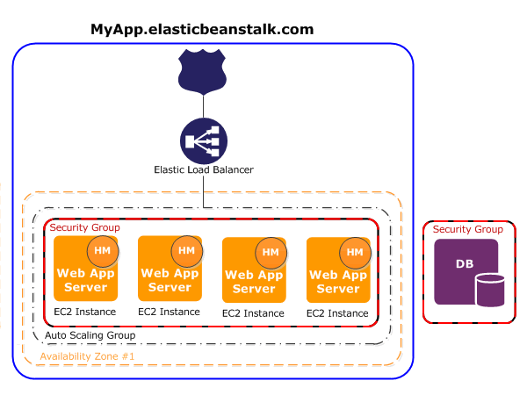
AWS Features - Beanstalk
Platform as a Service (PaaS): AWS Elastic Beanstalk is a fully managed PaaS that abstracts the underlying infrastructure complexities, allowing developers to focus on application code, not server management.
Application Deployment: It supports multiple programming languages and web frameworks, enabling easy deployment of web applications and services, including automatic scaling.
Environment Management: Elastic Beanstalk allows you to create multiple environments (e.g., development, staging, production) to facilitate testing, scaling, and version control of your applications.
Automatic Scaling: It provides built-in auto-scaling capabilities, adjusting the infrastructure resources based on application load, ensuring optimal performance and cost-efficiency.
Integration with AWS Services: Elastic Beanstalk seamlessly integrates with other AWS services like RDS (Relational Database Service), S3 (Simple Storage Service), and CloudWatch, making it easier to build robust and scalable applications.

Slide 7
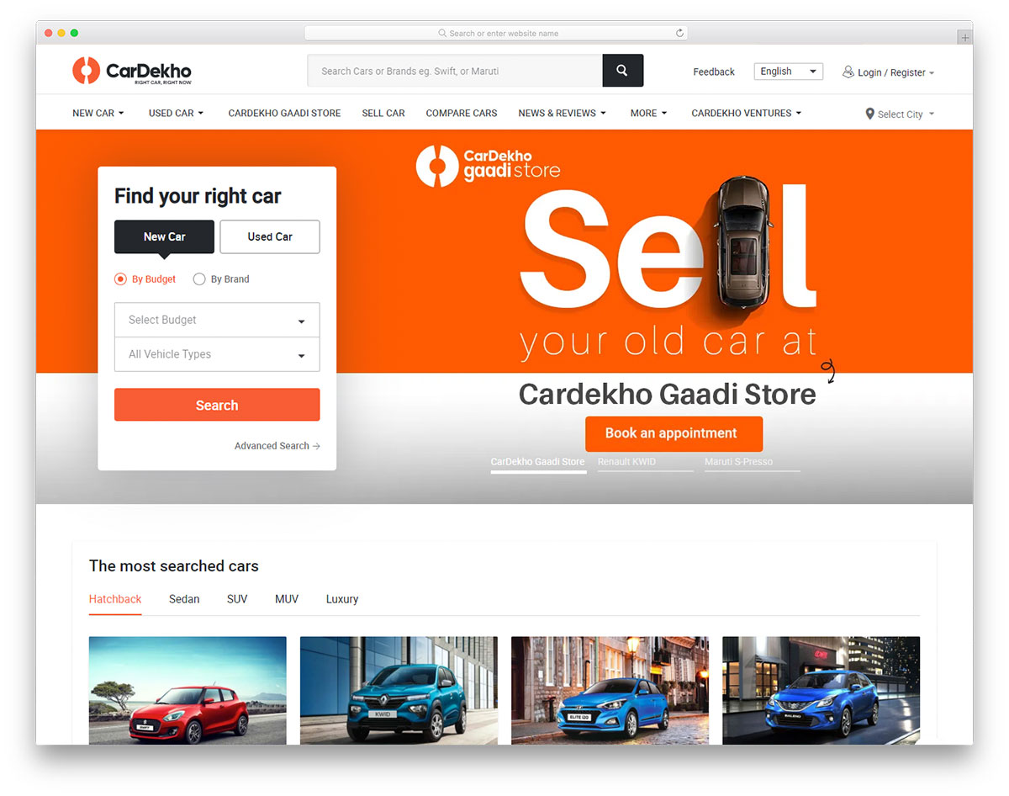



Project Architecture – AWS Services roles
Jupyter Notebook on EC2 Instance
Deployment on AWS Beanstalk
Data Cleaning: Remove duplicates, handle missing values
Feature Engineering: Create or modify features.
Model Training: Train a predictive model using regression algorithms.
Model Evaluation: Assess the model's accuracy and performance.
Design HTML UI for taking car attributes through the website and creation of “ebextensions” file for Beanstalk
Web Application Deployment: Deploy the model to predict resale prices for new data on Elastic Beanstalk
Vehicle dataset
SageMaker Model
Development
Deployment on AWS Beanstalk
Deployed web application

Slide 8
Data Preprocessing
Null Value Handling:
Check for and address any null values within the dataset through methods such as imputation or removal.
Age Calculation:
Convert the 'year' feature into the 'age' of the car by subtracting the manufacturing year from the current year.
Categorical Data Transformation:
Convert categorical data like fuel type, model name, seller type, and car transmission into numerical format using one-hot encoding.

Slide 9
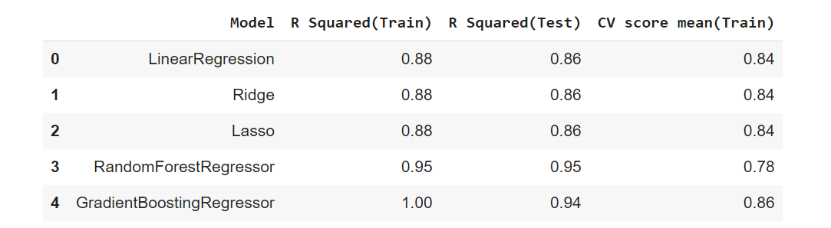
Model Creation and Evaluation
Testing regression models and their R2 score

Slide 10
Outcomes
AI Price Prediction:
Develop a robust AI model capable of accurately predicting the price of a car based on its attributes.
Implement machine learning techniques to continually improve the model's accuracy over time.
Simple Web Application:
Host our website in order to make our project accessible across the web
To Create an intuitive and user-friendly web application where users can input car attributes.
Enable users to receive instant car price predictions, accompanied by a user-friendly interface.

Slide 11
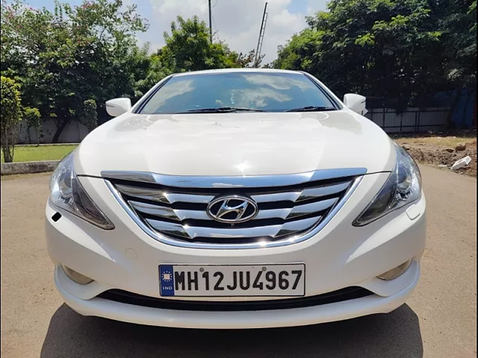
Live Demo
AWS Deployed Link : http://carpredictionmodel-env.eba-a2tbmgqe.us-east-1.elasticbeanstalk.com/
GitHub Link: https://github.com/PranavC10/CC_Group1_Car_price_pred
Features | Values
Purchases price of the Car | 15 lacs INR
KMs Driven | 50,000
Past Owners | 1
Age of the Car | 5
Transmission | Manual
Seller Type | Individual
Fuel Type | Petrol

Slide 12
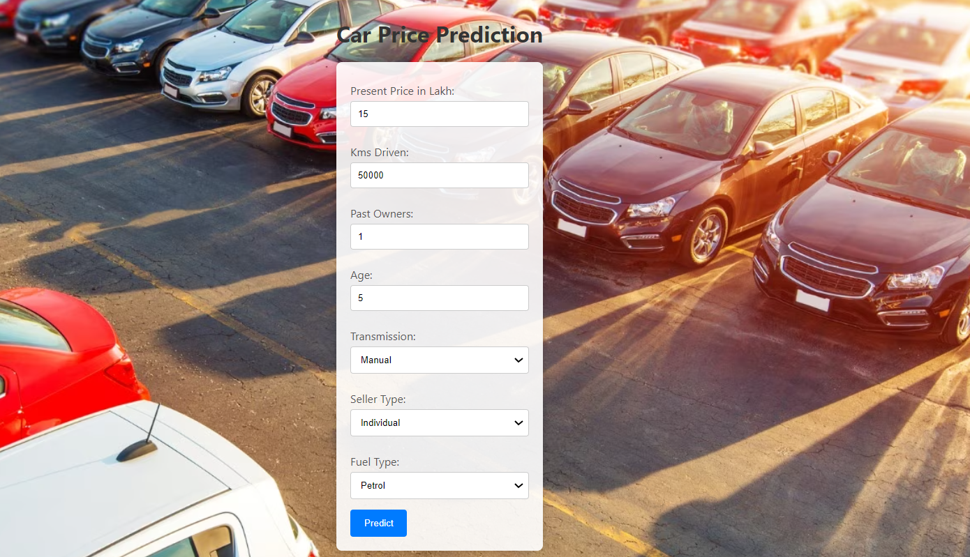
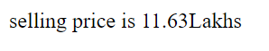
Results
Output

Slide 13
Thank you

